Slide 1
Creating A Language Translator Using NMT and LSTM Encoder-Decoder Model
SIMULATION AND MODELLING (UCS751) Project
Submitted By :
Arpit Sagar 102003130 4CO6
Anshita 102003182 4CO8
Submitted To :
Dr. Sanjeev Rao
November 2023

Slide 2
INTRODUCTION
In an interconnected world, accurate language translation is essential as traditional methods face limitations in capturing contextual nuances. There is a constant growing demand for efficient and precise language translation solutions.
Language translation involves more than word substitution, requiring deep comprehension.
Constructing an effective Neural Machine Translation (NMT) model for English to French translation.

Slide 3
TECHNOLOGY USED
01
02
Sequence To Sequence Architecture
One Hot Encoding
04
03
Encoder-Decoder Architecture with LSTM
GloVe Word Embeddings

Slide 4
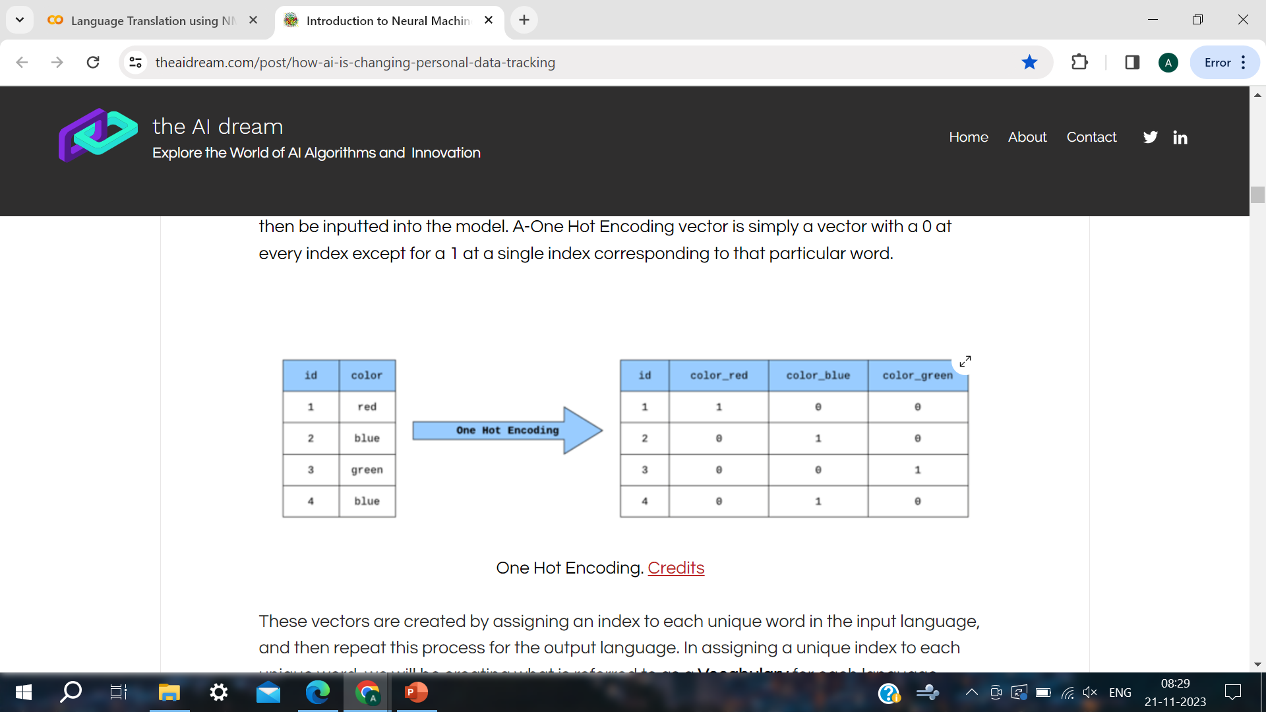
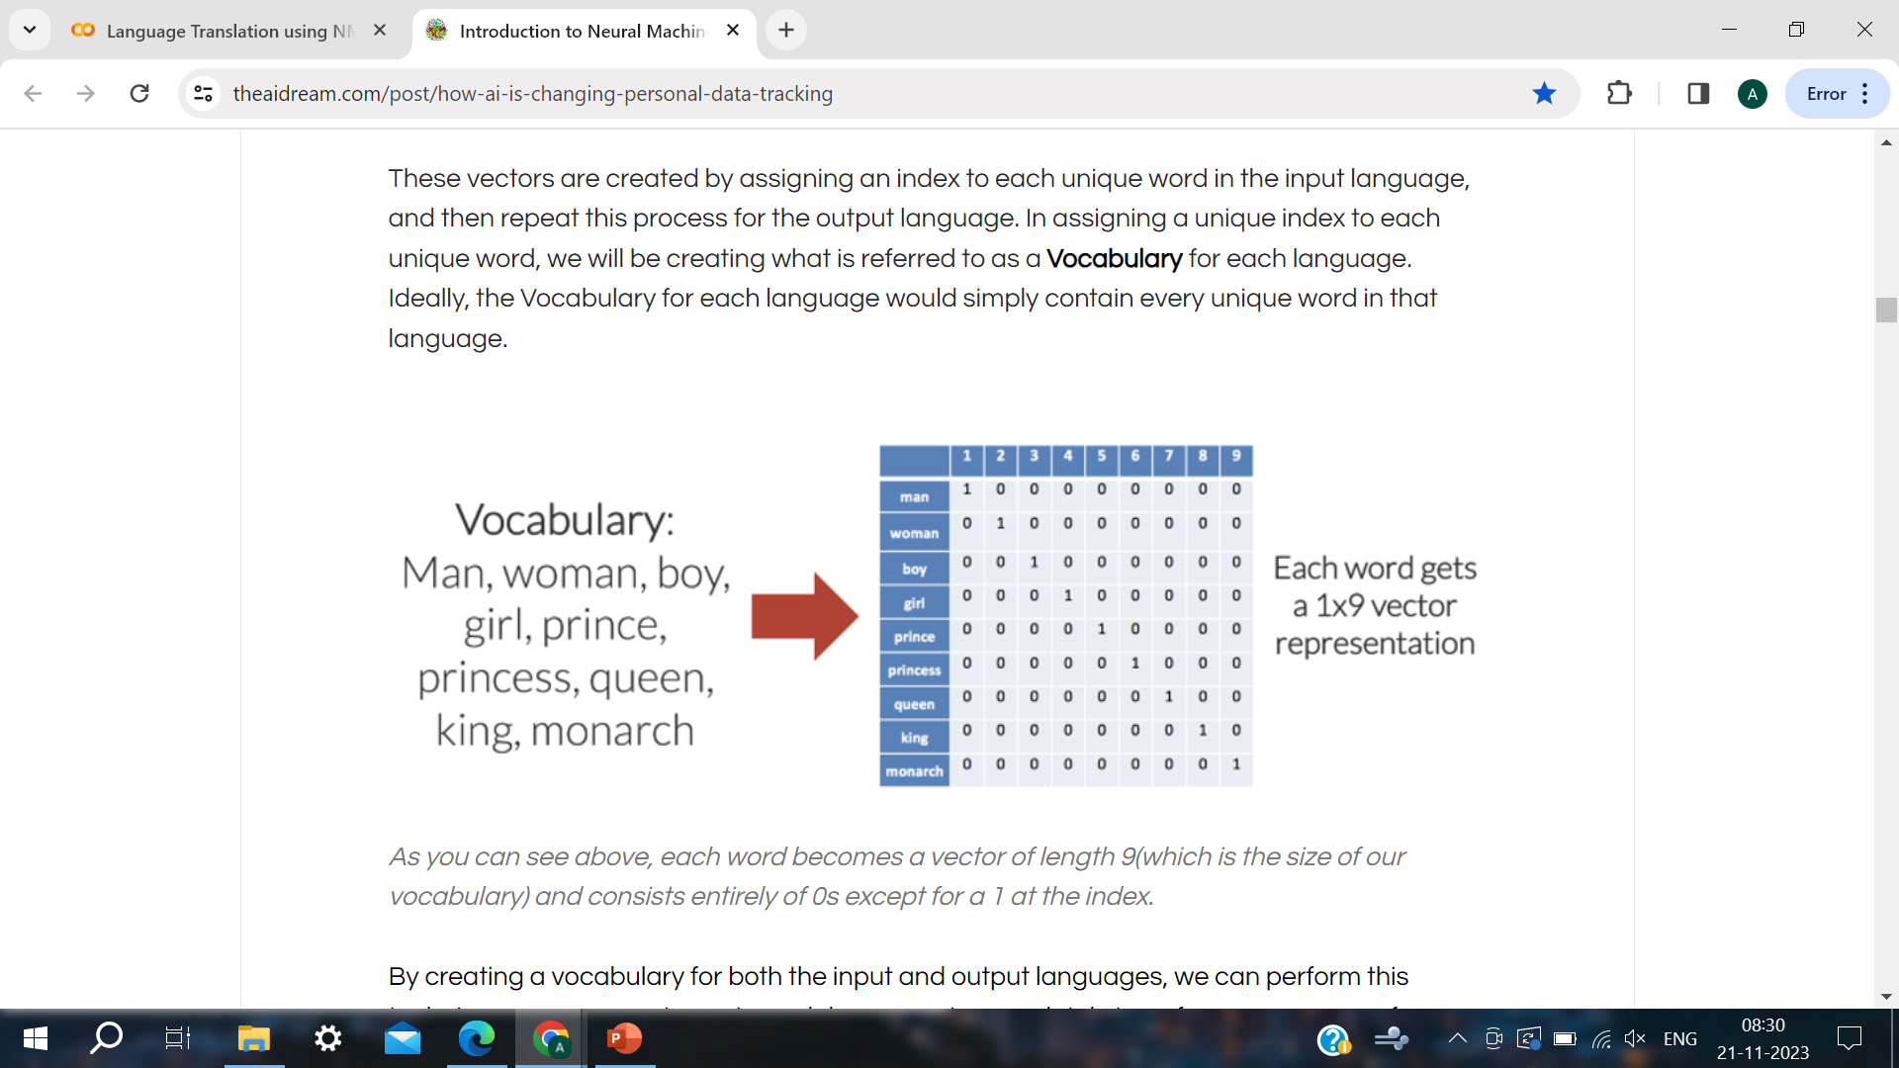
Workflow of the Project

Slide 5
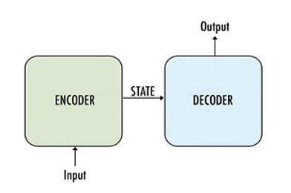

Working Of Encoder - Decoder Architecture
Workflow of the Project

Slide 6
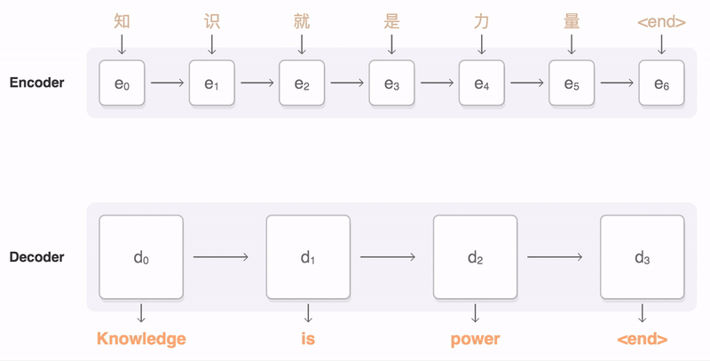
Encoder – Decoder in Action

Slide 7
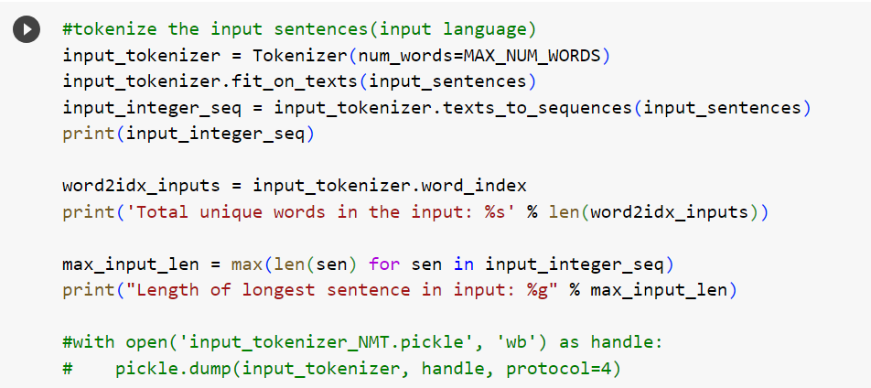
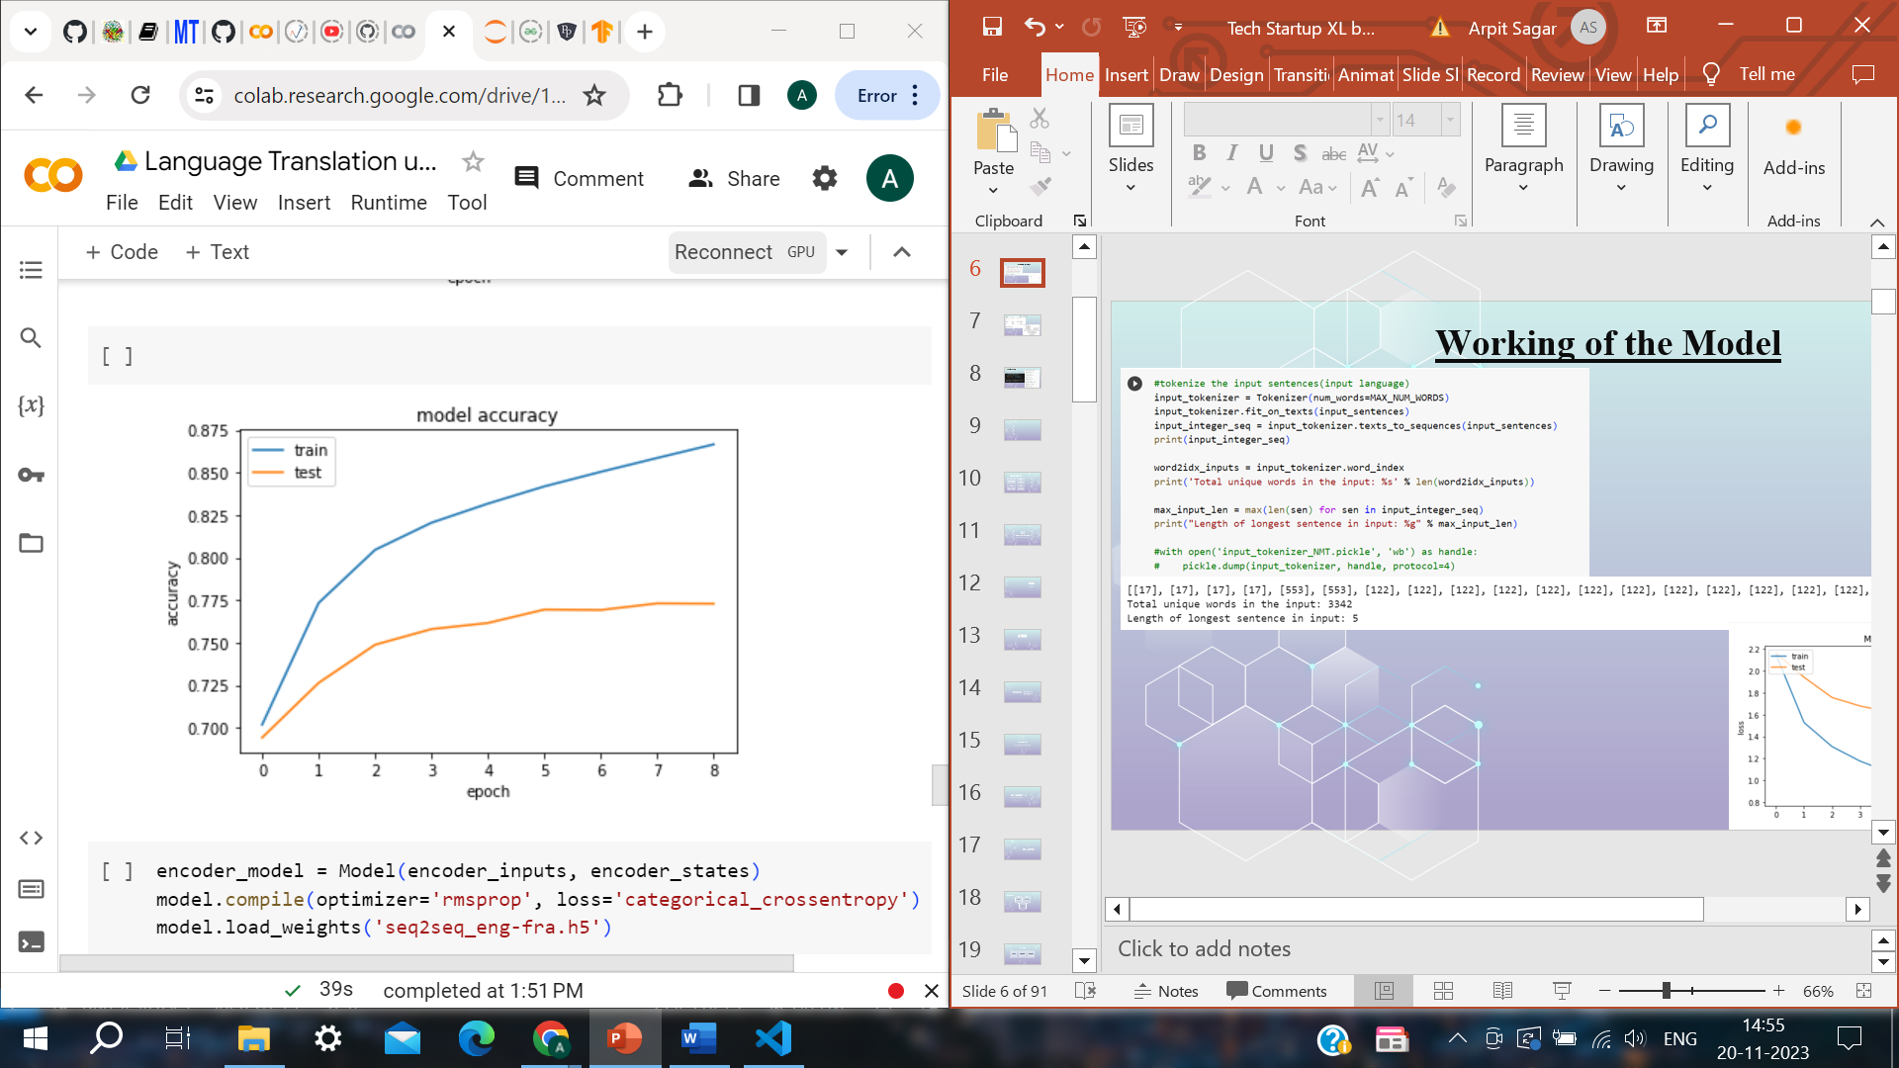
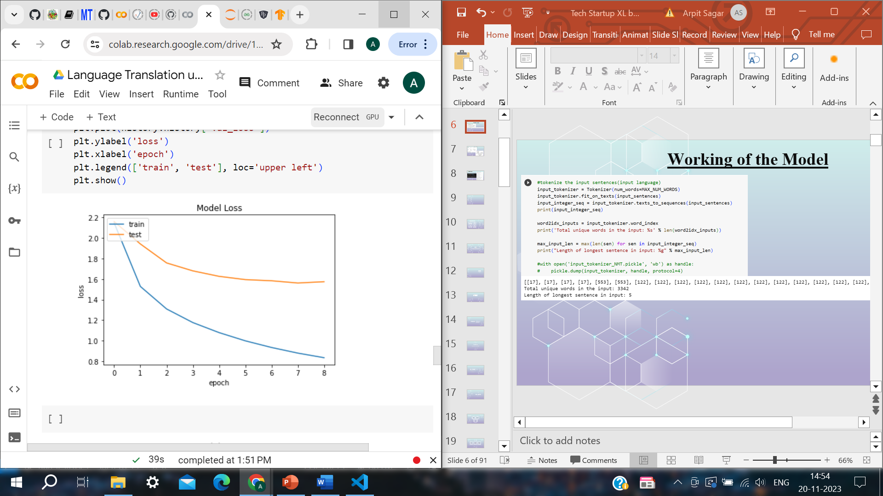
Working of the Model

Slide 8
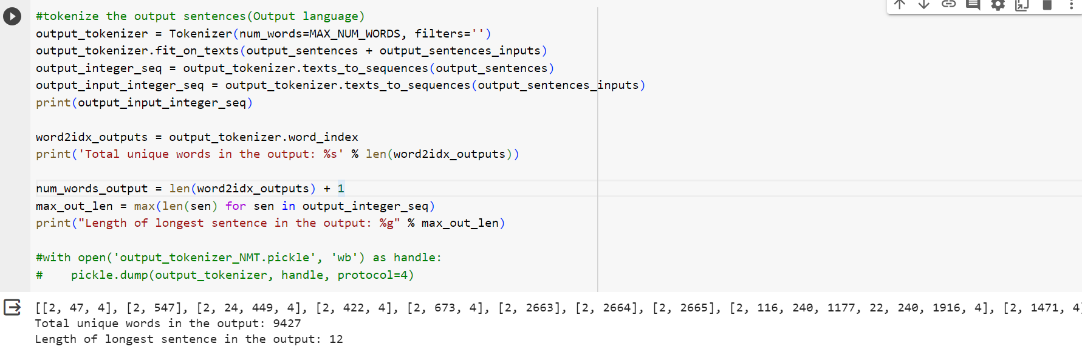
Working of the Model

Slide 9
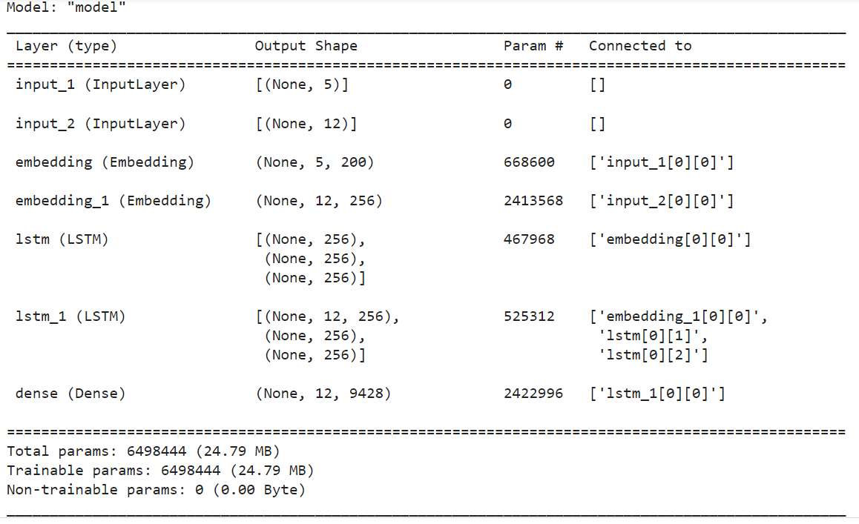
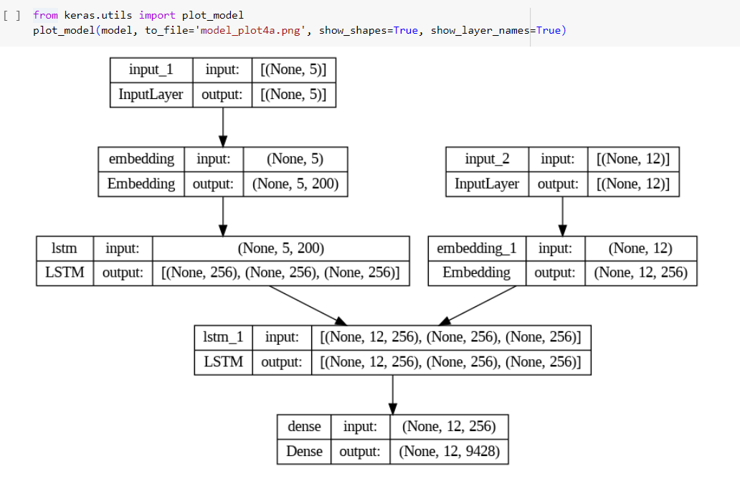
Working of the Model

Slide 10
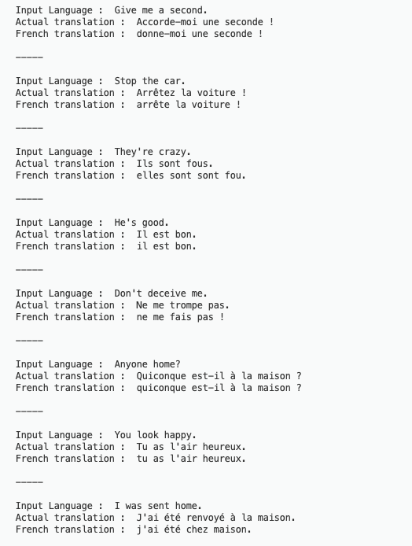
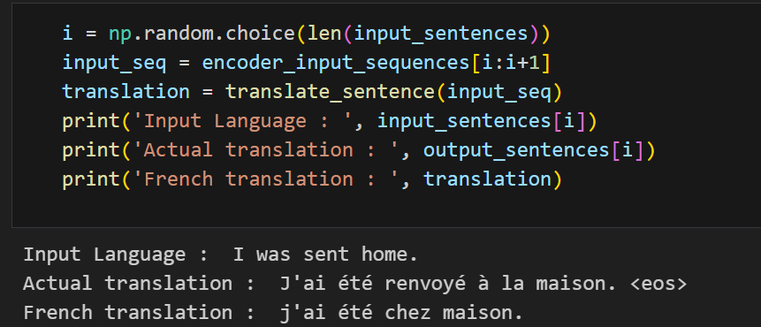
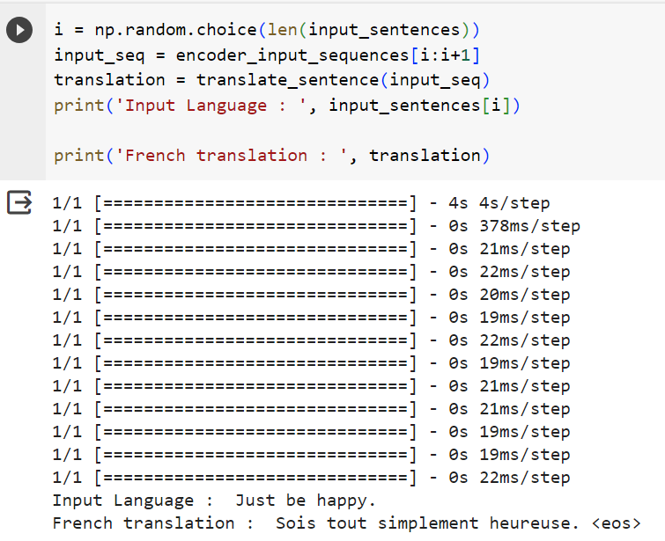
Output Snippets

Slide 11
CONCLUSION
Successful implementation of Neural Machine Translation (NMT) with a focus on the Encoder-Decoder architecture and LSTM networks.
Addressed the critical need for accurate language translation, recognizing limitations in traditional methods.
The Sequence-to-Sequence architecture, powered by Recurrent Neural Networks (RNN), showcased robust translation capabilities.
Key technologies, including One Hot Encoding and GloVe word embeddings, played crucial roles in data transformation and enhancing contextual understanding.
Achieved train accuracy of approximately 87% and test accuracy of around 77%, indicating strong learning and generalization capabilities.

Slide 12
THANK YOU

